Slide 1
The influence of the Dutch weather on the health of horses
Faculty of electrical engineering, mathematics and Computer science
Data management & biometrics
Josje van ‘t Padje
Notes:
Thank you mannes for the INTRODUCTION
Good morning everyone, welcome to my presentation and off course a HAPPY NEW YEAR

Slide 2
Motivation & background
Research Questions
Methodology& Results
Conclusion
Questions
Notes:
I will start this presentation with the motivation and background for this research,
followed by the research questions answered during this research
Followed by the methods used to answer these questions and the results obtained by these methods
During the conclusion I will answer the RQs
Afterwards there is time for questions

Slide 3
Motivation & Background
1.
Motivation & Background
Research Questions
Methodology & Results
Conclusion
Questions

Slide 4
Assumptions
High amounts of wind causes colic
High humidity causes respiratory problems
High humidity causes fungal infections on the skin
Muddy pastures cause mud fever
High sugar in grass, due to cold nights causes, laminitis
Motivation & Background
Research Questions
Methodology & Results
Conclusion
Questions
Notes:
Many HORSE OWNERS AND EQUINE PROFESSIONALS make ASSUMPTIONS about the health of horses and the CAUSES of diseases
Some of these assumptions CLAIM that specific weather conditions are responsible for PARTICULAR diseases.
For example -> see screen
The GOAL of this research is to determine which of these assumptions are true and which are false
This could help horse owners and professionals to ACCURATELY DIAGNOSE the horses

Slide 5
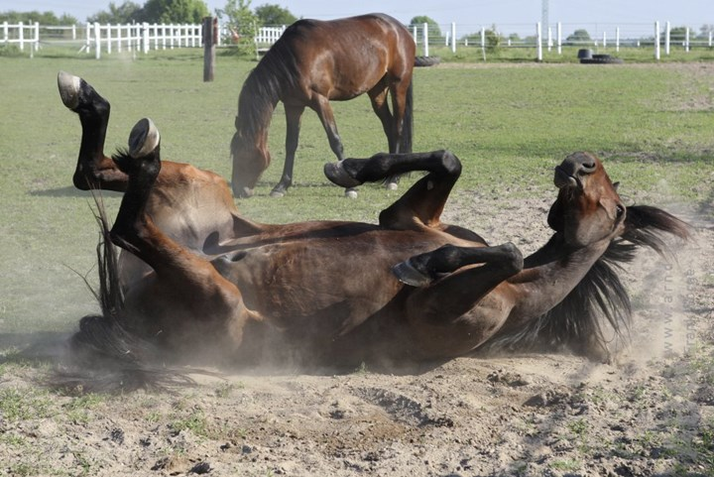
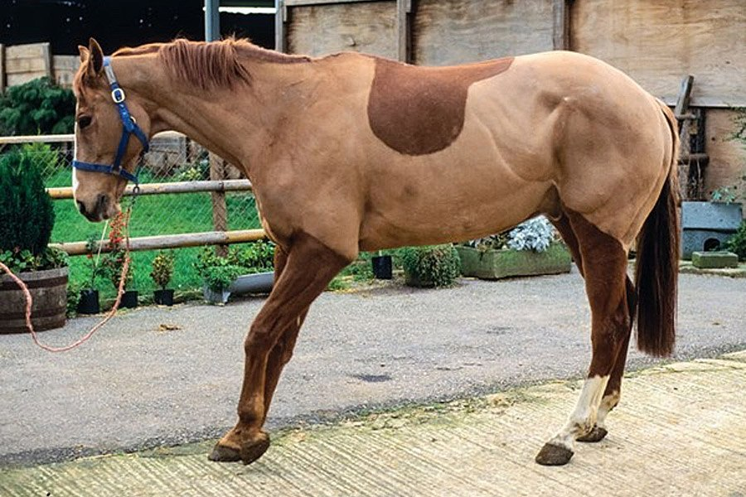
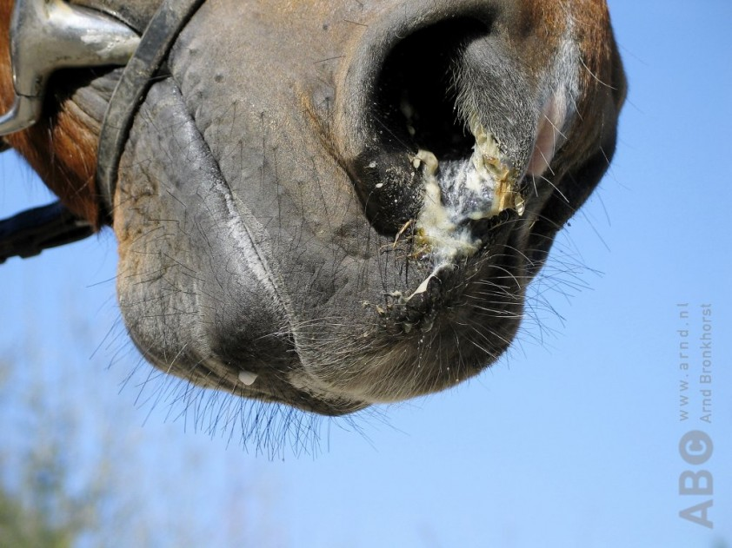
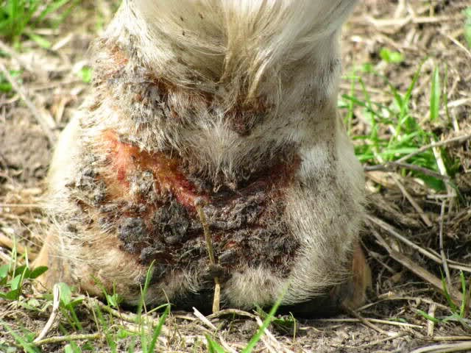
Diseases
Motivation & Background
Research Questions
Methodology & Results
Conclusion
Questions
Notes:
This research focusses on 4 diseases:
Colic, which is severe abdominal pain
Laminitis which is an INFLAMMATION in the hoofs
Respiratory disease covering everything from snotty noses and coughing to NEUMONIA
Skin disease like fungal and bacterial infections and ALLERGIC reactions. The most common one is mud fever: wounds just above the hoofs

Slide 6
Research questions
2.
Motivation & Background
Research Questions
Methodology & Results
Conclusion
Questions
Notes:
The research questions for this research are based on a LITERATURE REVIEW, done for this research on the RELATION between the four disease and the weather

Slide 7
First Research Question
What is the influence of the Dutch weather on the health of horses?
Does the temperature, barometric pressure and high amount of wind influence the occurrence of colic?
Is the development of laminitis dependent on stress in the grass, due to cold and drought?
Does hot, humid or cold weather worsen or induce respiratory disease?
Do skin diseases occur more in periods of heavy rainfall and high humidity?
Motivation & Background
Research Questions
Methodology & Results
Conclusion
Questions
Notes:
The first question is [reed screen]
This question is divided into 4 sub questions:
[read form screen]

Slide 8
Second Research Question
To what extent can the Dutch weather be used to predict the occurrence of ...
… colic ?
… laminitis?
… respiratory disease?
… skin disease?
Motivation & Background
Research Questions
Methodology & Results
Conclusion
Questions
Notes:
The second research question is [reed from screen]

Slide 9
Methodology & results
3.
Motivation & Background
Research Questions
Methodology & Results
Conclusion
Questions

Slide 10
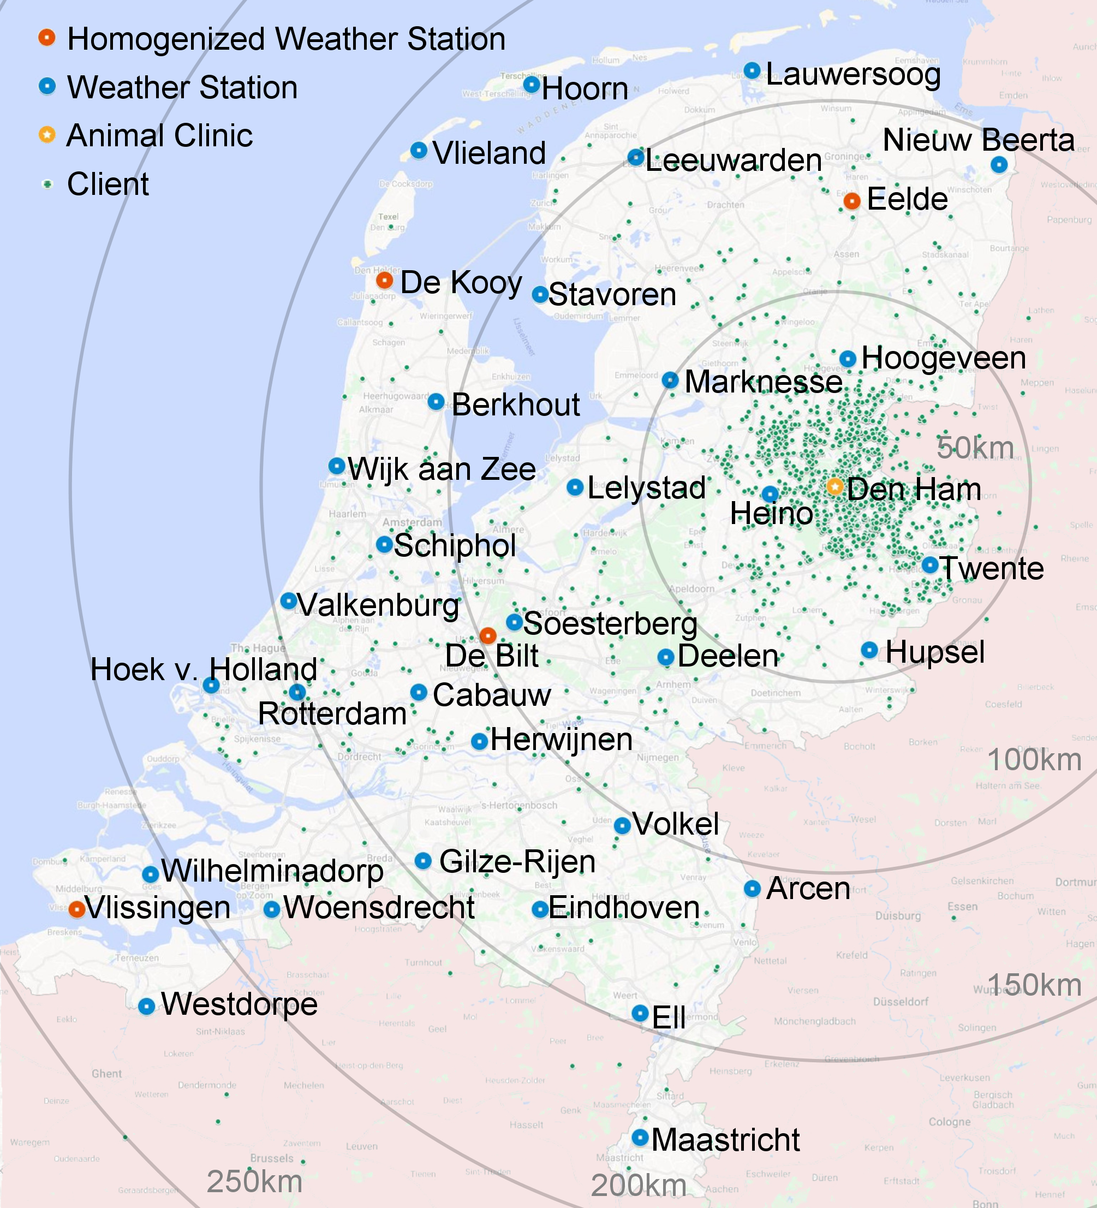
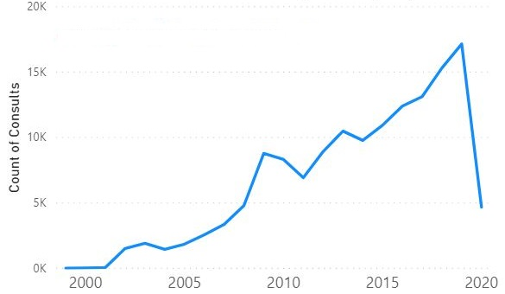
Data
144.400 lines in total
58.927 consults over 21 years
Motivation & Background
Research Questions
Methodology & Results
Conclusion
Questions
Notes:
For this research, two datasets are MERGED: the data of ANIMAL CLINIC DEN HAM and the weather data. For the weather data, the KNMI dataset of weather station Heino is used. Heino is the weather station that is closest to den ham. The weather data contains one row for each day in the dataset. For this research the period of
13 November 98 till 9 April 2020
This covers the data of the veterinarian, starting just a bit later, at
20 January 99 and ends on 9 April 2020 again.
The weather data contains 34 different variables such as the daily main wind speed, maximum wind speed and the hour in which this maximum is measured.
These variables are divided over 7 categories: WIND, TEMPERATURE, SUNSHINE DURATION, PRECIPITATION, BAROMETRIC PRESSURE, HUMIDITY AND EVAPORATION.
The data of the veterinarian consists of 144 thousand lines, each containing THINGS LIKE the horse, the owner, the veterinarian in CHARGE and an EXPLANATORY TEST OR THE MEDICATION GIVEN. So each consult consists of multiple rows, for each treatment, medication or explanation one.
For this research these lines are MERGED INTO CONSULTS, which are the lines form the same horse on the same day. This results into 60 thousand consults over the 21 years of data.

Slide 11
Labelling Consults
Disease | Keyword(s) | # Consults (keyword) | # Consults (labelling) | Accuracy (keyword) | Accuracy (labelling)
Colic | Koliek | 765 | 4196 | 0.99557 | 0.98893
Laminitis | Hoefbevangen | 196 | 5037 | 0.99077 | 0.97509
Respiratory | Snot, Luchtweg, Bronchitis, Longontsteking | 273 | 2007 | 0.99336 | 0.98727
Skin | Schimmel, Mok | 638 | 18135 | 0.99520 | 0.84613
Motivation & Background
Research Questions
Methodology & Results
Conclusion
Questions
Notes:
To work with the data, the consults all need a label with the DIAGNOSIS OR REASON for the consult. At first a keyword search is used to label the consults. This approach did give multiple PROBLEMS. A keyword could be a false positive when the word is used in a sentence like “this is not a case of …” or “the horse does not have a …” it could give a false negative when no text is given (this is the case for many consults), typos or spelling mistakes are made or when there are terms used that are not considered as key words. Also the count of the number of consults containing a keyword is very low, this is also CONFIRMED by the veterinarian. To fix these problems, 10.000 consults are labelled by hand. Using a binary labelling approach, where for each of the diseases a 1 or 0 is given for each of the diseases, if the horse is, or is not DIAGNOSED WITH THE DISEASE during the consult.
These hand labelled consults are used for automatic labelling. For this labelling a BAG of WORDS approach is used, using stochastic gradient descent, with different classifiers and loss functions for the different diseases.
Using machine learning to label the consults allows some of the consults without written text to also be labelled since the medication also can give an indication of the diagnosed disease. The hand labelled data is used to calculate the accuracy of the keyword search and the automatically labelled data. The accuracy of the keyword search is, most likely, less than shown here since the hand labelled data is mainly the data that contains text. Therefore there will be many false negatives in the rest of the data that is not used now to check the accuracy.

Slide 12
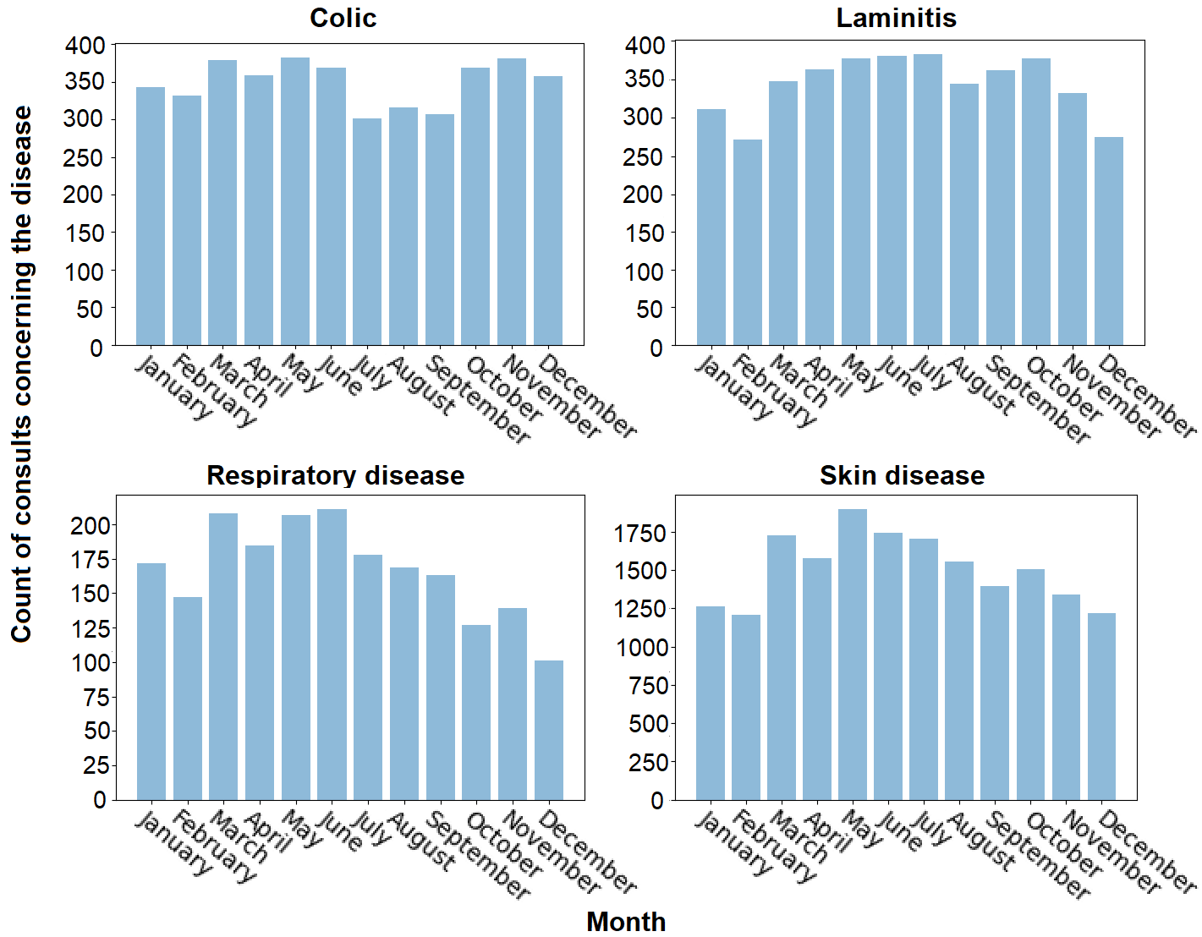
visualization
Motivation & Background
Research Questions
Methodology & Results
Conclusion
Questions
Notes:
To get more insight into the data, visualizations are made. These visualizations show the count of the consults concerning the different diseases for all year for each of the months.
The number of consults concerning colic lower during the summer months and highest from March to June and October to December. This is as expected by the expert. The LITERATURE pointed to a higher risk of colic in autumn and spring.
The number of consults concerning laminitis goes up from February and peaks in July and October. The expert explains the peek at the end of the year by the fact that horses nowadays are capt on the grass till late in the year due to climate change but the quality of the grass deteriorates throughout the year. The rising number of cases of laminitis during the spring and beginning of summer can be explained by the higher amounts of sunshine. The higher number of cases of laminitis during January, compared to December and February can be explained by the low temperatures
Most of the consults that concern respiratory disease and skin disease are seen in spring. For respiratory disease, literature suggested that winters give more problems than spring. Also the veterinarian was surprised by this outcome but he explained the high numbers in the spring by the fact that foals are more susceptible for respiratory diseases in their first months and since foals are mostly born in the spring and summer this could explain this peek early in the year.
The low number of skin diseases during the winter is in contrast with the related work suggesting that low temperatures could cause skin disease. But changes in the weather are mostly considered to cause skin diseases in horses however this is not visualized in this figure.

Slide 13
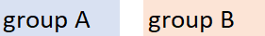
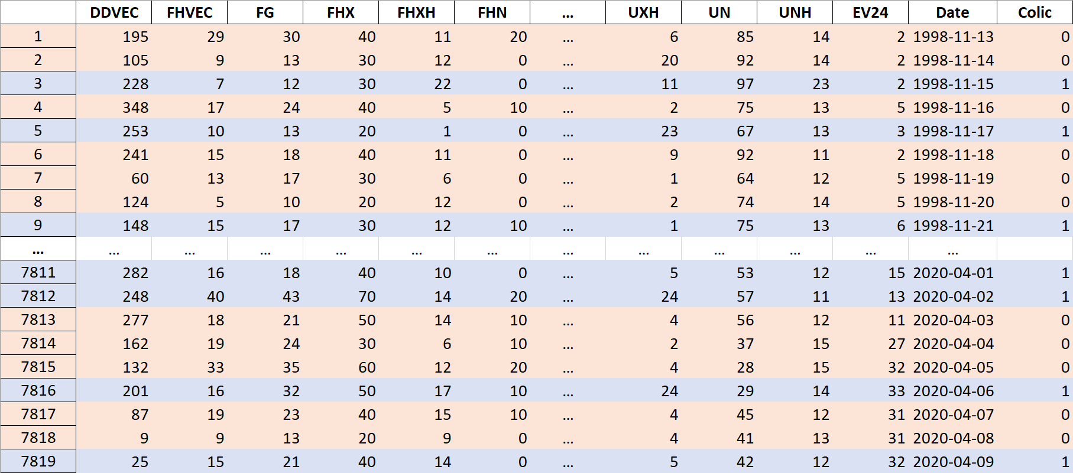
visualization
Motivation & Background
Research Questions
Methodology & Results
Conclusion
Questions
Notes:
For the following visualizations, the weather data is split into 2 groups, for each of the diseases disease. The table above is an example of how the groups are created. For the weather on current day group A consists of the blue rows, this are the rows on the days where colic was diagnosed in one or more consults. And group B are the remaining days. When we consider the weather on the the days before the disease, denoted with dt-1, the colour of the rows will be shifted to one row above, or the information in the rows will be shifted one row down for each row to create the new groups A and B, for dt-2 the colour will shift two rows above etc.

Slide 14
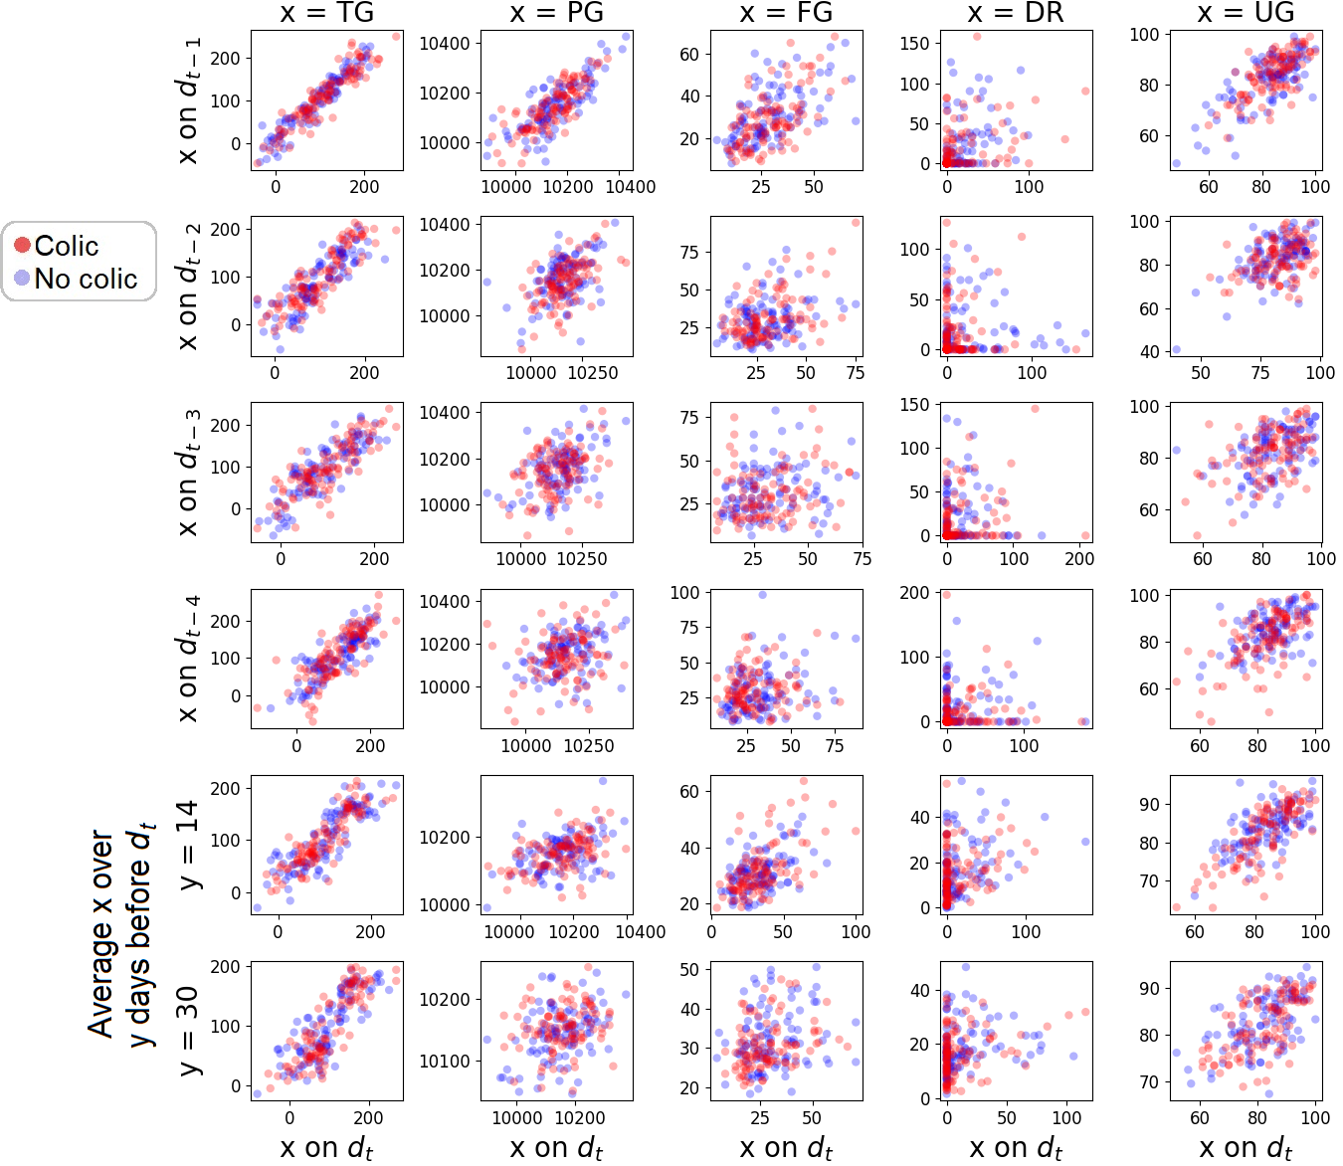
visualization
Motivation & Background
Research Questions
Methodology & Results
Conclusion
Questions
Notes:
To visualize the influence of changes in the weather on the different diseases, plots are made for each of the diseases and the 5 MOST MENTIONED weather variables: Daily Mean Temperature, Daily Mean Wind Speed, Daily Mean Barometric Pressure, Precipitation Duration and Daily Mean Relative Atmospheric Humidity. In these visualizations, the group A’s of the current day, so the dt-0 is plotted against the other time options. The same holds for group B, here resulting in the red dots for group A and the blue dots for group B. When a disease would correlate strongly to a change in one of these weather variables, many red dots in the upper left or lower right corner would be expected, without blue ones. As we can see the red and blue dots mostly follow the same patterns and therefore we can not conclude that the diseases correlate to changes in the weather. The images of the other diseases do look very similar.

Slide 15
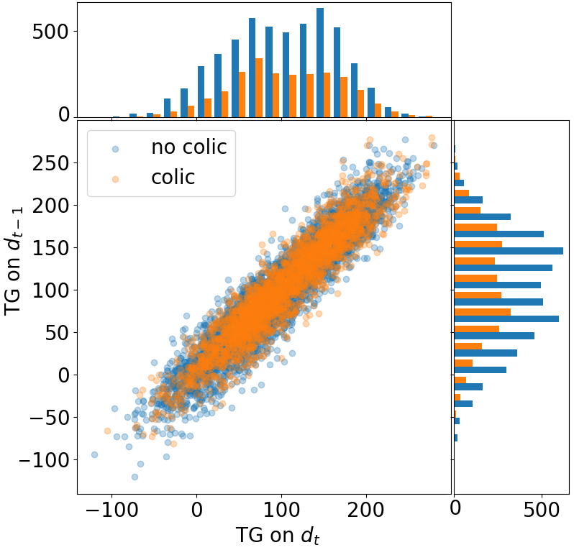
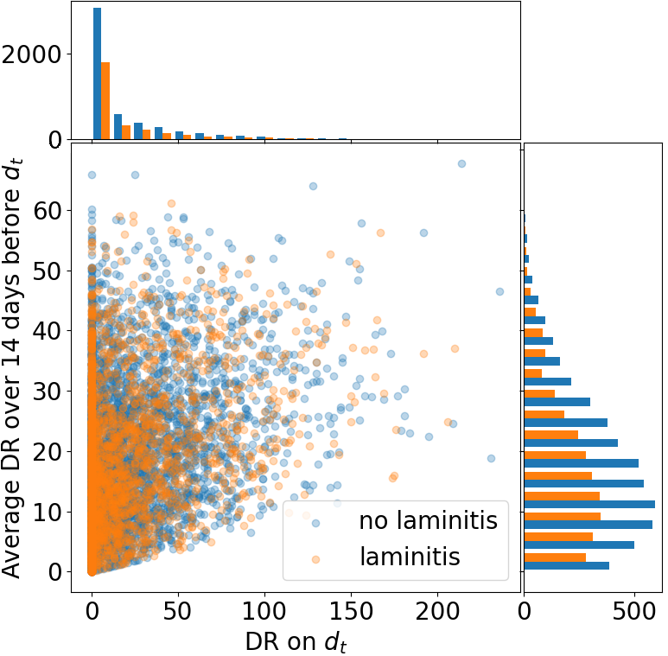
visualization
Motivation & Background
Research Questions
Methodology & Results
Conclusion
Questions
Notes:
To make this even more clear I have made two of these visualizations bigger. These visualizations show the same data as the previous ones. There are a lot more dots in these visualizations as in the previous ones. That is because the previous plots only contain 100 dots per class for each of the images. That is done because, as we can see here, the second class completely overrides the first one, which makes it unclear what happens under need all these orange dots. Therefore the HISTOGRAMS are added at the sides of the plots. Since the histograms show the same shape for both classes, we can conclude that both classes are very similar.
And again, when changes in the weather would correlate to the disease we would expect the classes to have different shapes.

Slide 16
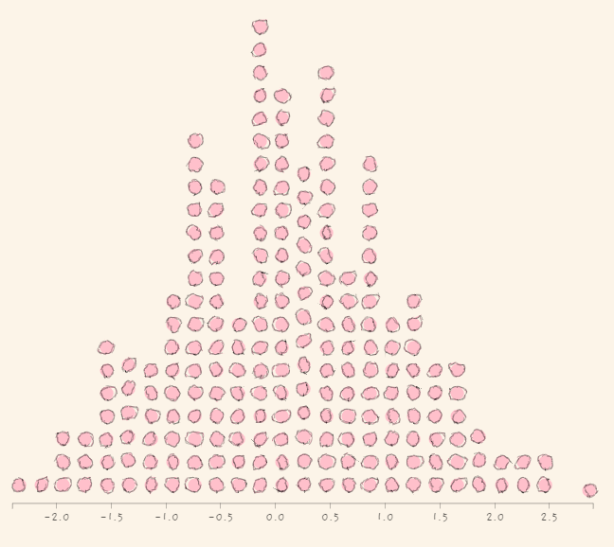
correlations
Motivation & Background
Research Questions
Methodology & Results
Conclusion
Questions
Notes:
As with the second visualizations, the weather data is split into groups A and B for the correlation analysis.
For the correlation analysis, I wanted to know if there is a significant difference between group A and group B or if this difference did occur by chance. For this, Permutation tests are used.
A permutation test works as follows:
The difference of the mean of the two groups is calculated. Then items in the groups are shuffled randomly and the difference in mean of these new groups is calculated again. This shuffling and calculation of the difference mean is done 1000 times.
When we would make a histogram of these plots we would get something like this. When the difference in mean of the actual group A and B is somewhere in the middle of this histogram, the probability that the difference in mean occurred by chance is quite large, while when this difference in mean is somewhere at the ends of the histogram this probability gets smaller. This probability is called the P_VALUE A permutation test is performed for each of the weather values, and diseases, to see which weather variables do have a correlation with the diseases

Slide 17
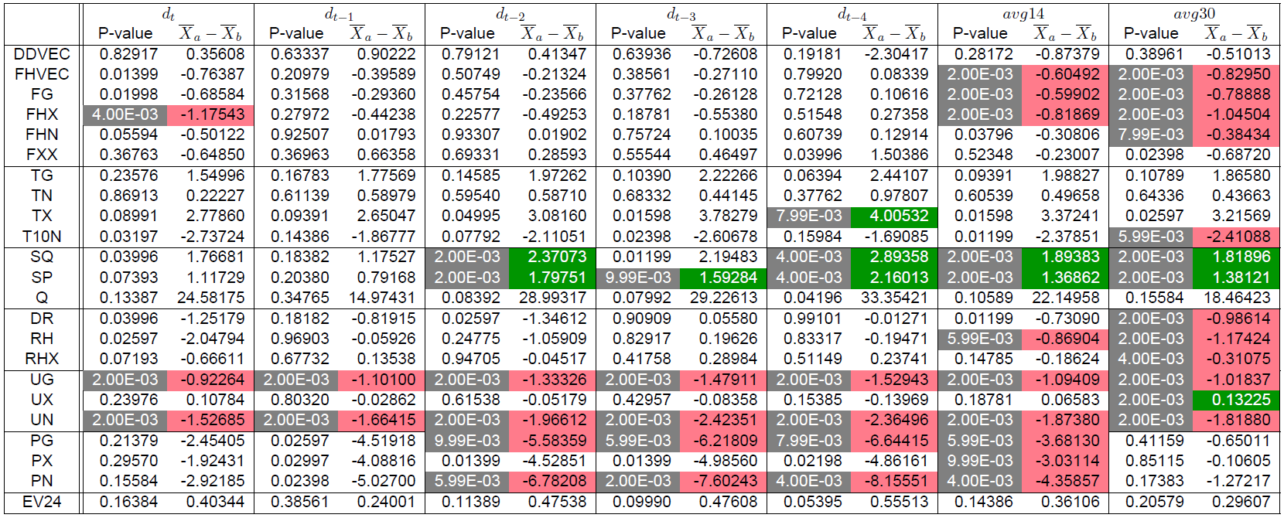
Correlations
Motivation & Background
Research Questions
Methodology & Results
Conclusion
Questions
Notes:
This correlation analysis resulted in four tables like these, one per disease. Here we have the p-value and difference in mean for each of the time periods and each of the weather variables. The gray cells indicate a p value below 0.01. meaning that there is a 1 % chance that the difference occurred by change and therefore 99% chance that the difference in mean is a actual difference. For the difference in mean holds that a green cell indicates a positive correlation (meaning that the value is higher when the disease occeurs) and the red cells indicate a negative correlation. For example TX has a green cell for dt-4, meaning that the maximum measured temperature (which TX stands for) on days where colic is diagnosed is 0.4 degrees higher than on the remaining days.
The differences in mean are very small, also for the variables where a correlation is found but according to the permutation test this is a significant difference, so the difference is bigger then with most of the random groups.

Slide 18
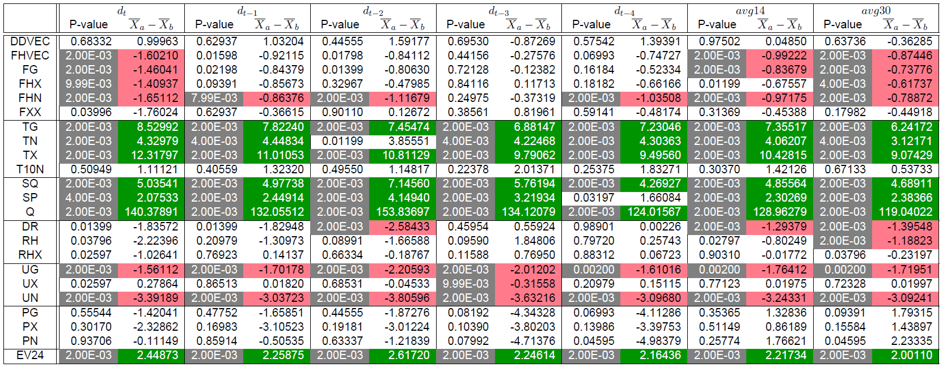
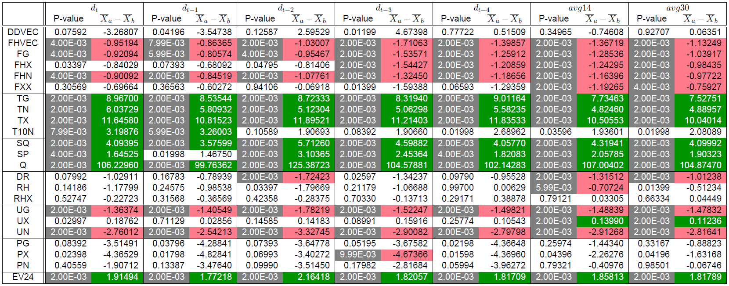
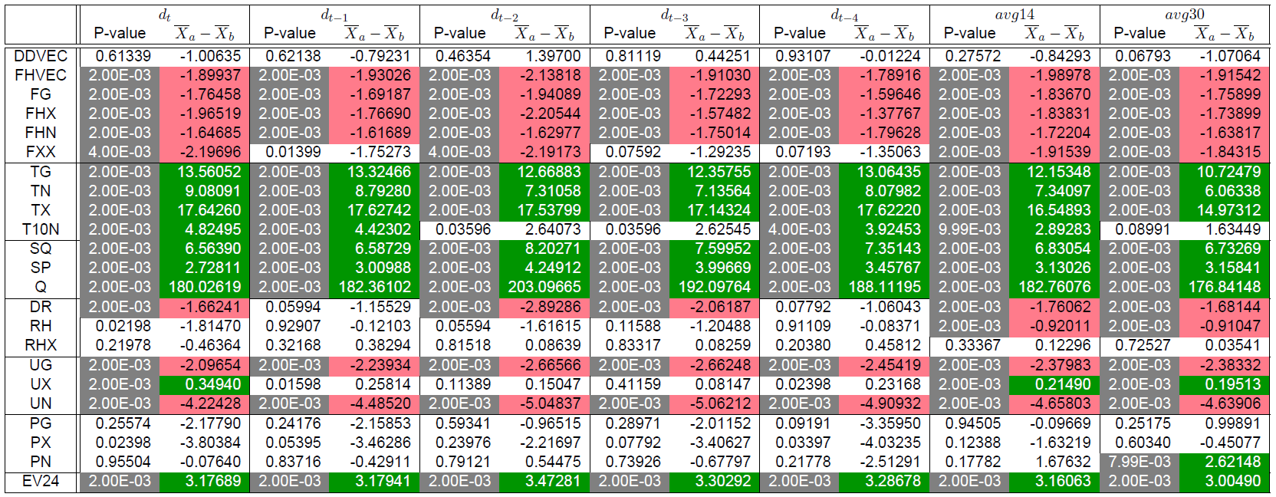
Correlations
Motivation & Background
Research Questions
Methodology & Results
Conclusion
Questions
Notes:
This gets quite small but this is an overview of the four tables: for colic, laminitis, respiratory disease and skin disease.
What stands out is that there are many correlations for all of the diseases and that, when a weather variable correlates to more then one disease, it always is positive for all or negative for al. If we take TX again, that is always positive for all four diseases for example.
Also I would have expected to see more specific weather conditions correlating to the different diseases but instead they do correlate a bit to all.

Slide 19
predictions
 | Single classifiers | Ensemble Predictions
 |  | Bagging | Boosting | Voting
Linear Regression
Support Vector Machine
Decision Tree
Neural Network
Motivation & Background
Research Questions
Methodology & Results
Conclusion
Questions
Notes:
Lastly I wanted to see to what extend it is possible to predict the diseases using the weather. According to the literature ensemble predictions work well when predicting with weather. Therefore I tested the 3 ensemble strategies: bagging, boosting and voting and COMPARED the results to single classifiers. Ensemble predictions work by combining one or more classifiers. Therefore I tested the classifiers linear regression, support vector machine, decision tree and neural network since these are also found to give good results when working with weather data and binary data. Per disease, the single classifier and bagging algorithm are performed four times, once for each of the classifiers. The boosting algorithm only works with decision trees and is therefore performed once. The voting algorithm also is performed just once since it combines the four classifiers into one model

Slide 20
predictions
 | Single classifiers | Ensemble Predictions
 |  | Bagging | Boosting | Voting
Colic | 0.67749 (LR) | 0.70102 (DT) | 0.69207 | 0.68338
Laminitis | 0.65162 (SVM, NN) | 0.64680 (DT) | 0.62583 | 0.63555
Respiratory | 0.79847 (SVM) | 0.79847 (SVM) | 0.79463 | 0.79847
Skin | 0.66803 (LR) | 0.74194 (DT) | 0.72225 | 0.66215
Motivation & Background
Research Questions
Methodology & Results
Conclusion
Questions
Notes:
Here is an overview of the accuracies of the classifiers. For the single classifiers and the bagging algorithm, only the best accuracy is shown, and within the brackets the classifier or classifiers are given. As you can see, there is not much difference between the different classification strategies.

Slide 21
Conclusion
6.
Motivation & Background
Research Questions
Methodology & Results
Conclusion
Questions

Slide 22
Answer to First Research Question
What is the influence of the Dutch weather on the health of horses?
Does the temperature, barometric pressure and high amount of wind influence the occurrence of colic?
Is the development of laminitis dependent on stress in the grass, due to cold and drought?
Does hot, humid or cold weather worsen or induce respiratory disease?
Do skin diseases occur more in periods of heavy rainfall and high humidity?
Motivation & Background
Research Questions
Methodology & Results
Conclusion
Questions
Notes:
A short recap of the first RQ: we wanted to know the influence of the ducht weather on the health of horses. Lets first focus on the sub questions

Slide 23
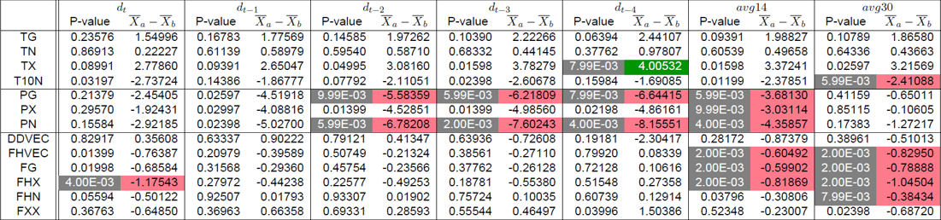
Answer to First Research Question
1. Does the temperature, barometric pressure and high amount of wind influence the occurrence of colic?
Motivation & Background
Research Questions
Methodology & Results
Conclusion
Questions
Notes:
All three weather categories do have some correlation with colic but the wind has a negative correlation, while a positive correlation was expected. Also the literature suggests that a high barometric pressure is correlated while we also find a low pressure to be correlated.

Slide 24
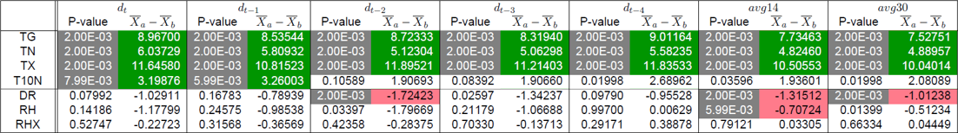
Answer to First Research Question
2. Is the development of laminitis dependent on stress in the grass, due to cold and drought?
Motivation & Background
Research Questions
Methodology & Results
Conclusion
Questions
Notes:
The temperature is correlated with laminitis, but the correlation found is positive, which suggests that a higher temperature is correlated with laminitis. Drought is indeed correlated with laminitis.

Slide 25
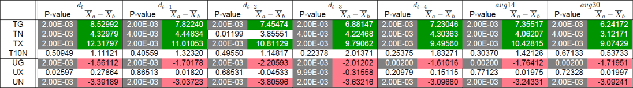
Answer to First Research Question
3. Does hot, humid or cold weather worsen or induce respiratory disease?
Motivation & Background
Research Questions
Methodology & Results
Conclusion
Questions
Notes:
For respiratory disease we indeed see a positive correlation between the temperature and the disease but also a lower humidity.

Slide 26
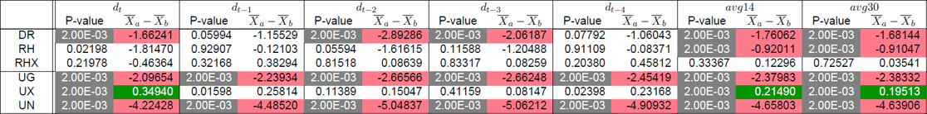
Answer to First Research Question
4. Do skin diseases occur more in periods of heavy rainfall and high humidity?
Motivation & Background
Research Questions
Methodology & Results
Conclusion
Questions
Notes:
For skin disease we see that less rain and a lower average, higher maximum and lower minimum humidity is correlated to the disease

Slide 27
Answer to First Research Question
What is the influence of the Dutch weather on the health of horses?
Does the temperature, barometric pressure and high amount of wind influence the occurrence of colic?
Is the development of laminitis dependent on stress in the grass, due to cold and drought?
Does hot, humid or cold weather worsen or induce respiratory disease?
Do skin diseases occur more in periods of heavy rainfall and high humidity?
Motivation & Background
Research Questions
Methodology & Results
Conclusion
Questions
Notes:
Even though a lot of correlations are found, in general the diseases do not seem to correlate to specific weather conditions.

Slide 28
Answer to Second Research Question
To what extent can the Dutch weather be used to predict the occurrence of ...
… colic ? 70.1% accurate
… laminitis? 65.2% accurate
… respiratory disease? 79.8% accurate
… skin disease? 74.2% accurate
Motivation & Background
Research Questions
Methodology & Results
Conclusion
Questions
Notes:
The second research question was to what extend the diseases could be predicted using the weather. Respiratory disease is most accurate to predict with almost 80% accuracy. Laminitis is the hardest to predict with an accuracy of 65%. Since 50% accuracy is compete randomness I would say that the prediction of the diseases in general is not very good.

Slide 29
Questions?
Motivation & Background
Research Questions
Methodology & Results
Conclusion
Questions
Notes:
Thank you for listening to my presentation. Are there any questions?

Slide 30
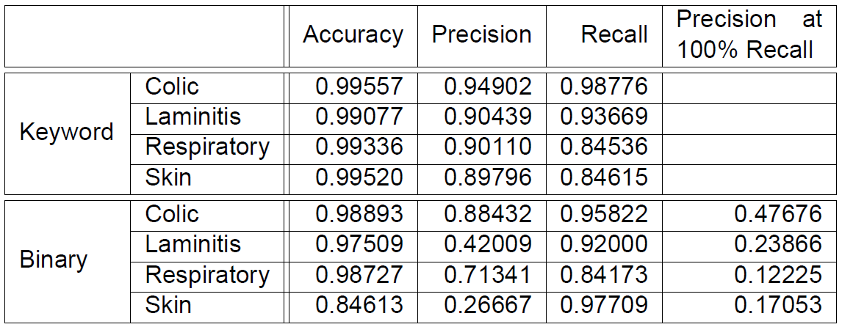
Questions

